Slide 1

ECONCLIMA2 – Grant Agreement Preparation
DREAM
GreenREFORM-EU
8 OCTOBER 2026
Meeting with SG REFORM
Jens Sand Kirk, Mathilde Lindstrøm-Svendsen and Thomas Nyvang, DREAM
DREAM · Danish Research Institute for Economic Analysis and Modelling
dreamgruppen.dk

Slide 2

Agenda
Completion of the ‘GreenREFORM 2.0’ project
The question for today: encode changes now, or amend later ?
  Two budget corrections - grant total unchanged
  Proposed changes to the DoA
  Staff change
  Realocation of ressources between WP’s

Slide 3
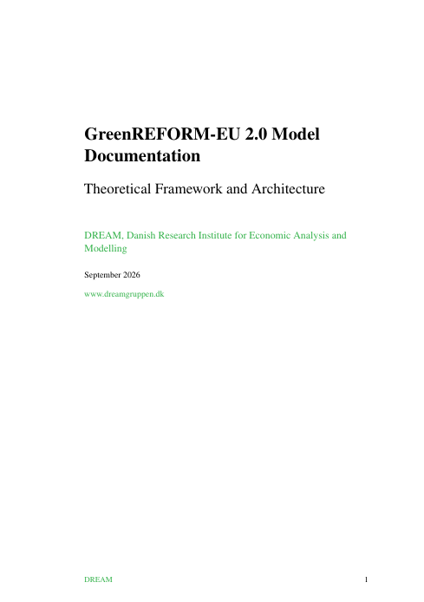
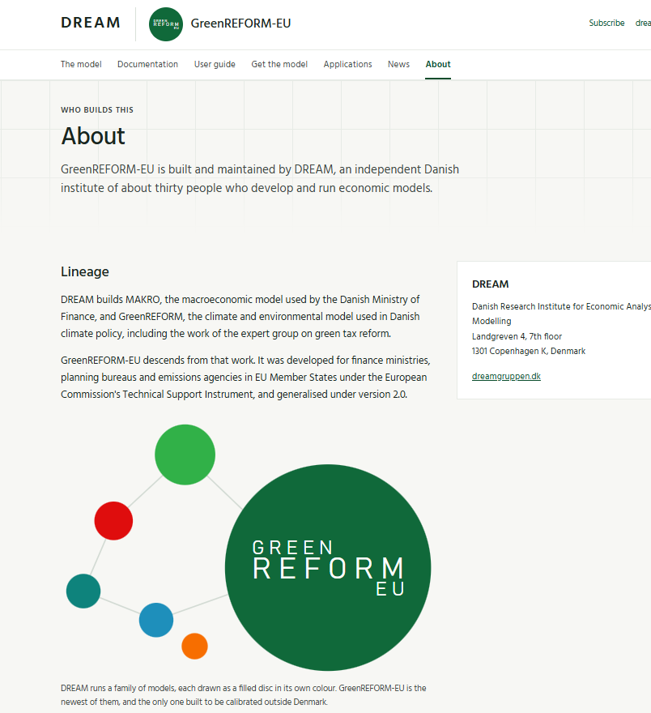
Completion of the ‘GreenREFORM 2.0’ project
Direct support for FI, BE, and IT has been provided as needed.
To my understanding:
BE is expecting to publish analysis on the model this year
FI is making steady progress, and IT as well albeit at a slower pace
The team in AU is struggeling with ressource allocation.
The key deliverable of the project is an improved version of the GreenREFORM EU model with a solid documentation and user guide published on a dedicated website (Mockup) in time for the launch of ECONCLIMA2 – Let’s coordinate !

Slide 4
The question for today
Should we encode the budget reallocations now, during grant agreement preparation, or discuss them later as an amendment?
The invitation letter says we may normally not change the project or the budget, unless you ask us to.
SG REFORM Finance wrote on 10 September that small, well-justified adjustments to the budget and the Description of the Action are still possible in GAP, and that the requested amount cannot exceed the maximum grant.
We accept that the total grant cannot change. The two budget items below are our own budgeting errors. We will offset them elsewhere in the budget.

Slide 5
Two budget corrections
WP5 - introduction seminar
The proposal includes venue, catering and IT at EUR 18,667, booked under WP1, calculated for 30 people.
Travel and accommodation are already budgeted for 39 participants.
With our own staff we should plan for 42.
Extra venue and catering: about EUR 4,800.
WP13 - final workshop
Travel, accommodation and subsistence for participants are in the budget.
Room and catering are not.
About EUR 10,400 for 39 people over two days.

Slide 6
Proposed changes to the DoA
D2.1 User guide (Server): due date brought forward from month 26 to month 7, so it is available when the Member States start the active phase.
S4.1 UNICPH (WP4): also covers T4.3 - non-specific model development and continuous updating of the documentation and user guide.
S7.1 UNICPH (WP7): also covers T7.3 - execution of the in-person training sessions, not only preparation.

Slide 7
Staff change
João Miguel Ejarque, Senior Economist at DREAM, is no longer employed by DREAM.
We propose to replace him in section 1.7 by a staff member not yet appointed (NA). The role is unchanged.
The associated effort and costs are unchanged: 3.5 person-months in WP4 and 2 person-months in WP9, retained in Part A under NA.
We would also like to amend the budget allocation in light of updated staff costs.

Slide 8
Realocation of ressources between WP’s

